Slide 1
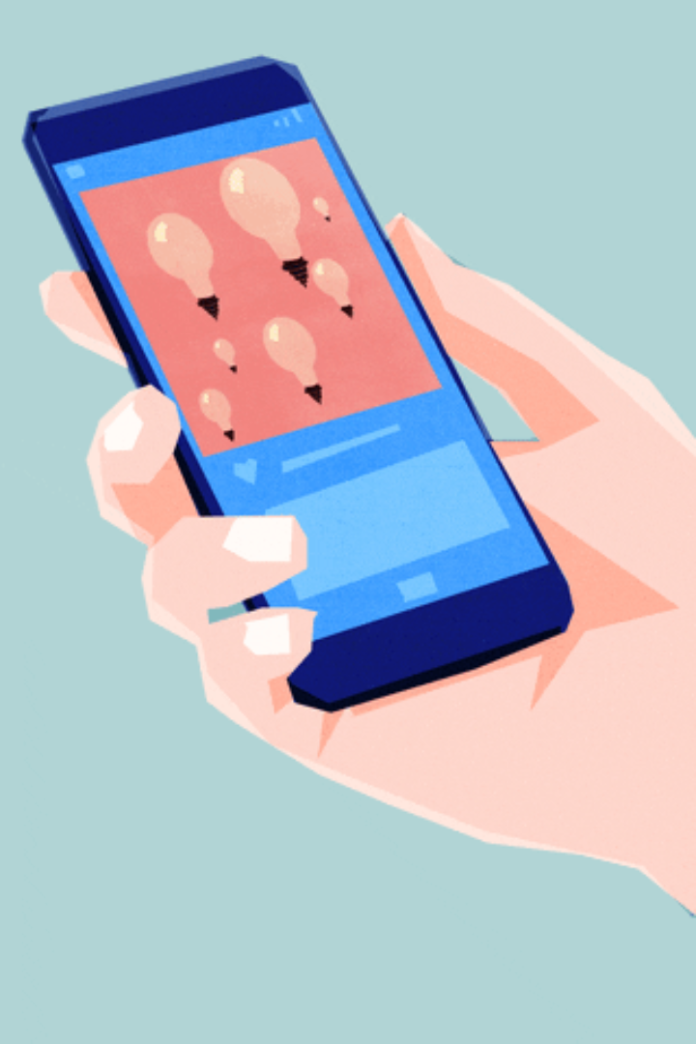
Mobile Device Usage and User Behavior Analysis
B.RAHUL SHARMA 111723720002

Slide 2

Abstract
This project aims to develop a classification model for predicting user behavior patterns based on mobile device usage data. The dataset, consisting of 700 instances and 11 features, includes attributes such as app usage time, screen on time, battery drain, the number of apps installed, and data usage, as well as demographic information like age and gender. By employing classification algorithms, the model predicts user behavior classes, providing insights into how mobile usage characteristics vary across different user profiles.

Slide 3
Introduction
This dataset is taken from Kaggle website.The provided dataset contains mobile device usage and user behavior data with 700 entries and 11 attributes, including features such as App Usage Time (minutes/day), Screen On Time (hours/day), Battery Drain (mAh/day), Number of Apps Installed, Data Usage (MB/day), Age, Gender, and more. Each record is classified into a User Behavior Class (e.g., Heavy User, Regular User, Occasional User), making it suitable for classification tasks related to mobile user behavior.

Slide 4
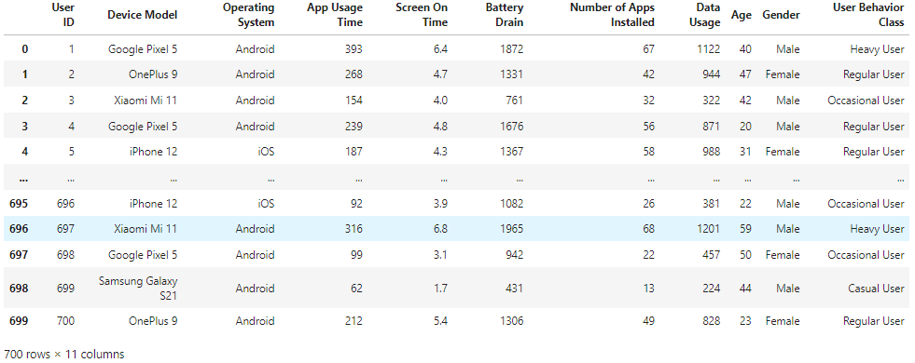
About the Dataset
The dataset consists of 700 rows and 11 columns.

Slide 5
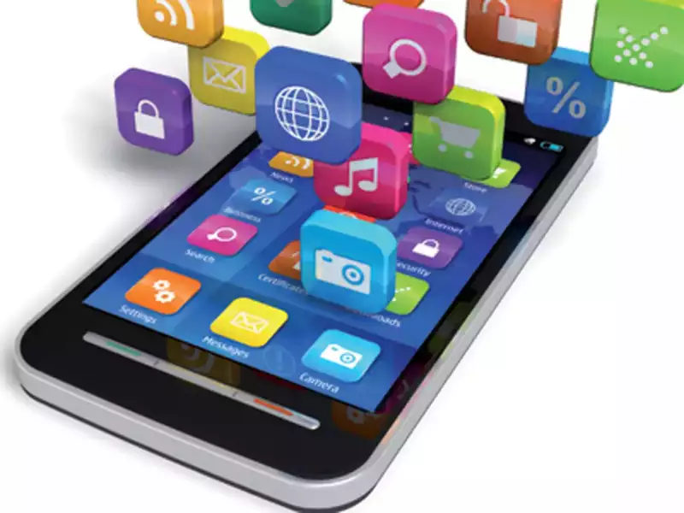
Feature Selection
App usage time (minutes/day)
Screen On Time (hours/day)
Number of Apps Installed
Age
Operating System(Android/ios)
Data Usage (MB/day)

Slide 6
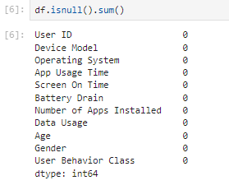
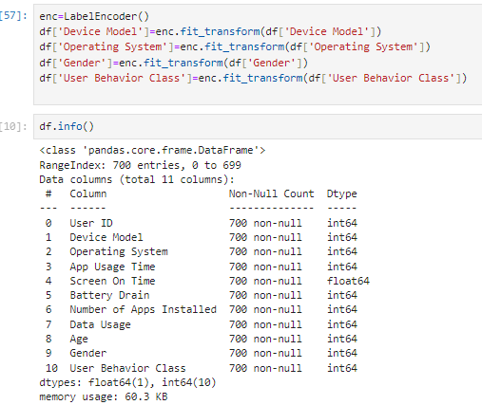
Preprocessing
1. Null values
2. Feature converted

Slide 7
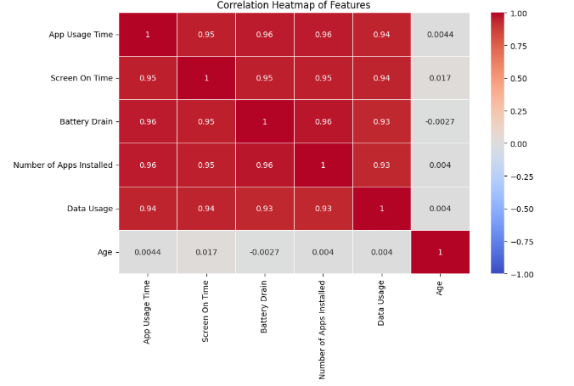
Feature selection

Slide 8

Algorithms Used
As my project is a classification problem. I have used the following classification machine learning algorithms.
1.Logistic regression -66.34920634920634
2.Support vector classifier -91.587301158730158
3.Decision tree classifier -93.61904761904762
4.Random forest classifier – 97
5.K nearest neighbors classifier-94.25396825396825
Out of all the algorithms I have used Random forest as the best model for my dataset

Slide 9





Libraries Used
PANDAS (manipulation and analysis)
NUMPY (working with arrays)
MATPLOTLIB (plotting library for the python)
TKINTER (standard GUI library for python)
PICKLE (serializing and deserializing a Python object structure)

Slide 10
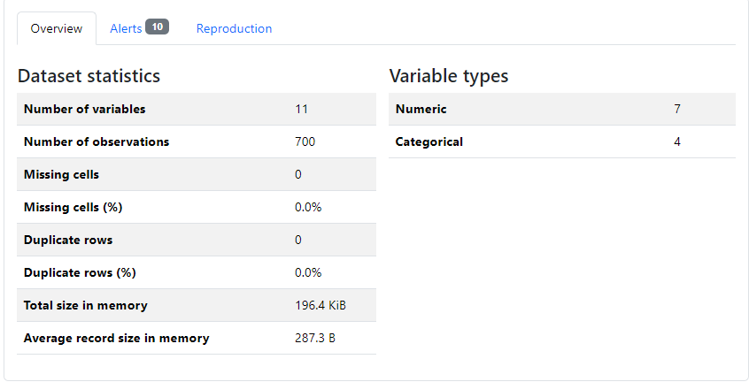
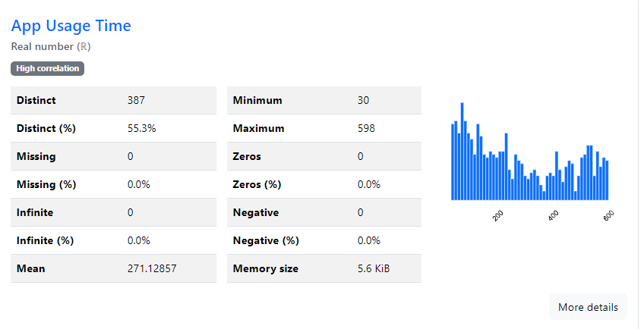
Exploratory Data Analysis (EDA)
By Pandas Profiling Report
\\

Slide 11
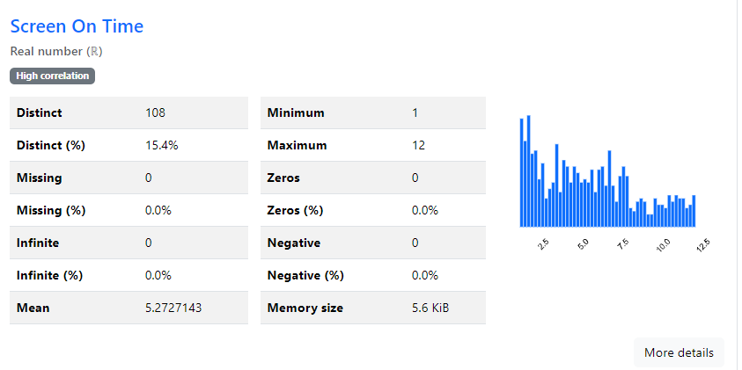
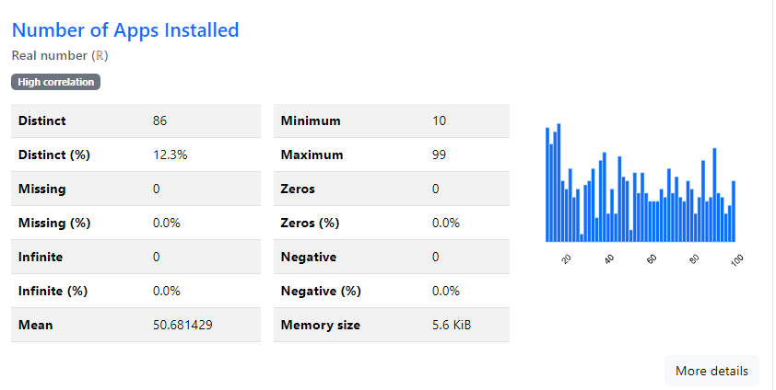
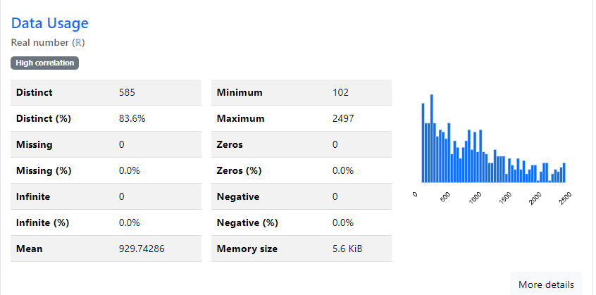
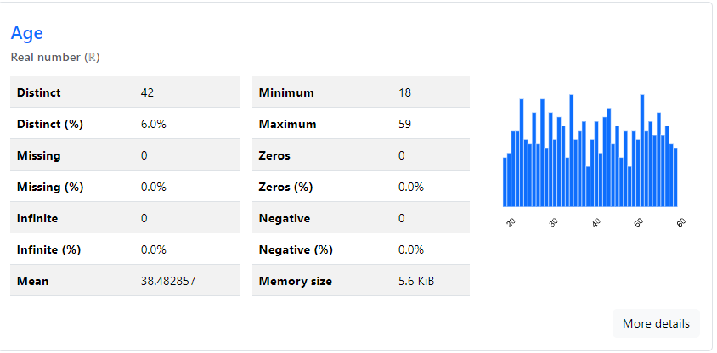

Slide 12
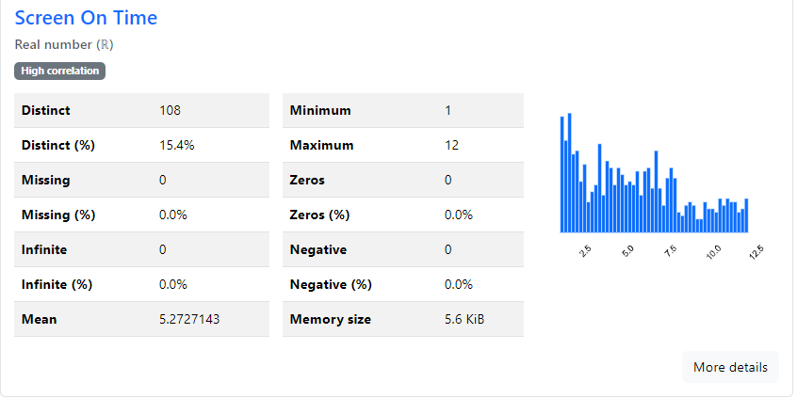
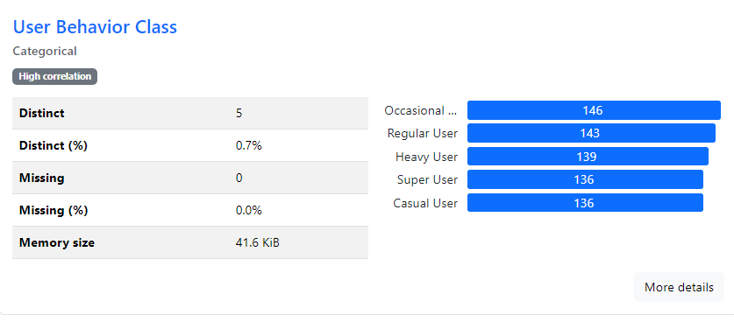

Slide 13
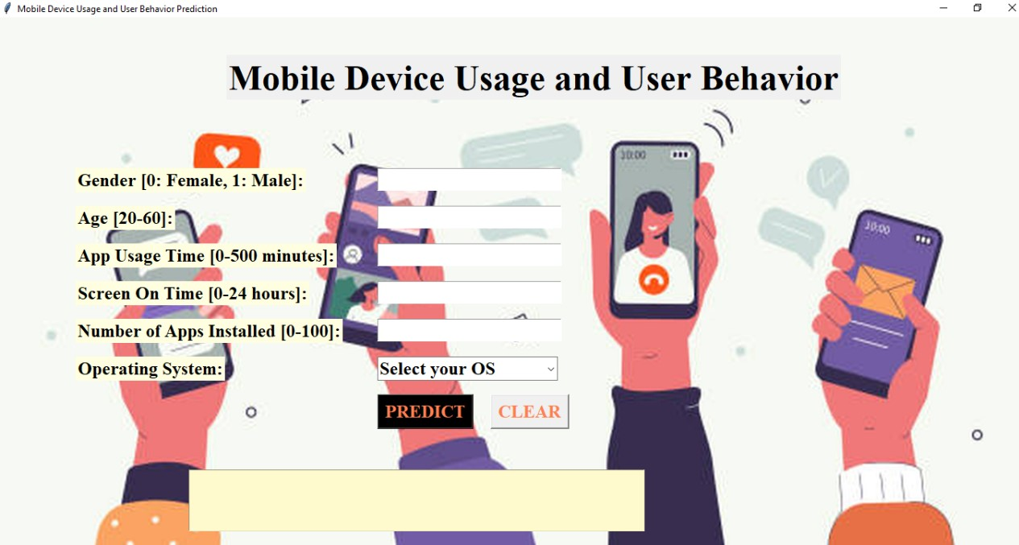
Deployment of GUI

Slide 14
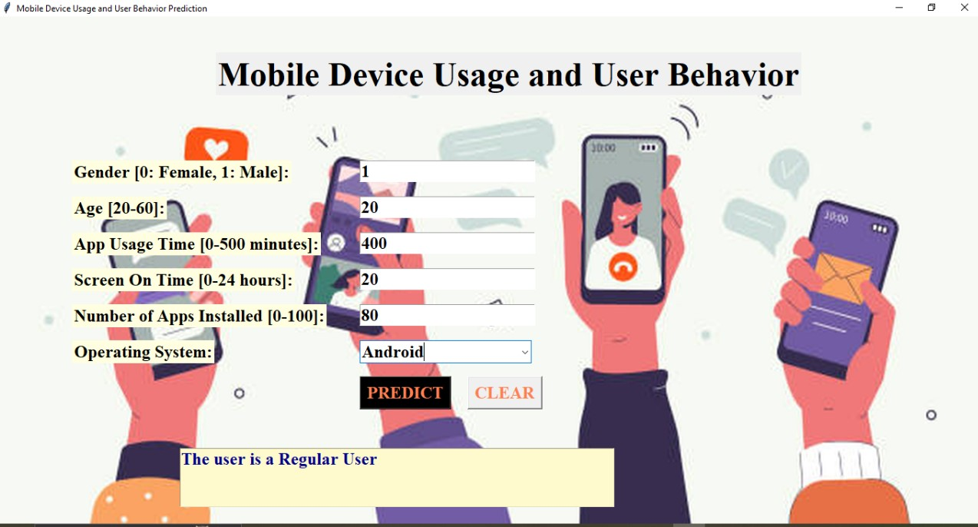
Result of GUI

Slide 15
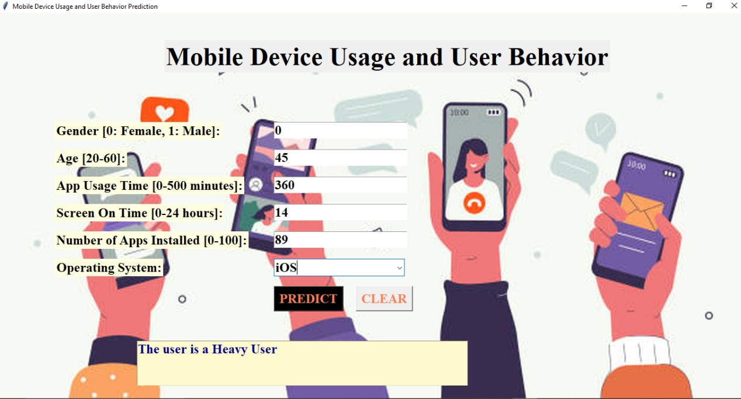

Slide 16
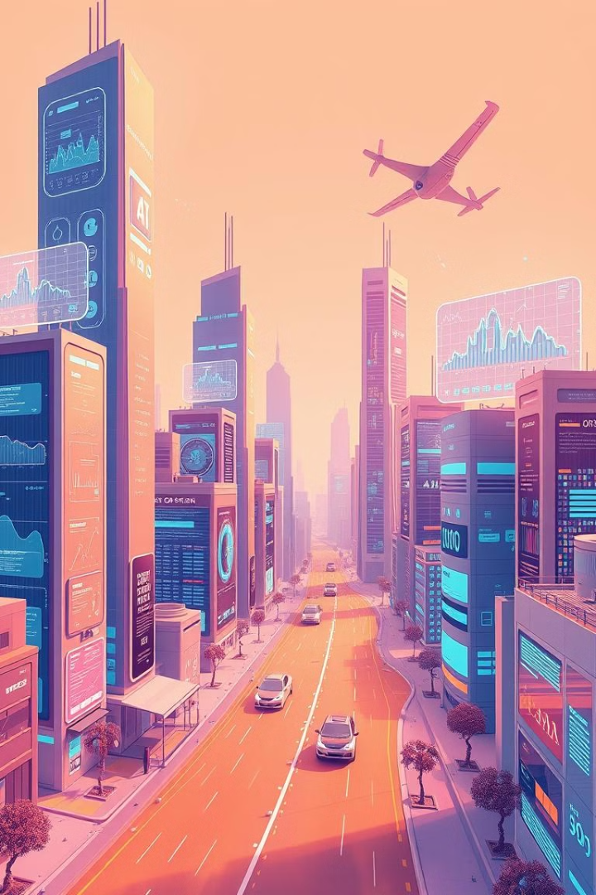
CONCLUSION
Based on the analysis, your dataset reveals key insights about user behavior. Features like App Usage Time, Battery Drain, and Data Usage are highly correlated, indicating redundancy. This suggests that users with longer screen time tend to drain more battery and consume more data. Additionally, the inclusion of demographic features like Age and Operating System provides further context, helping classify users into behavior categories (e.g., Heavy, Regular, Occasional). Feature selection should focus on minimizing multicollinearity to improve model performance.

Slide 17
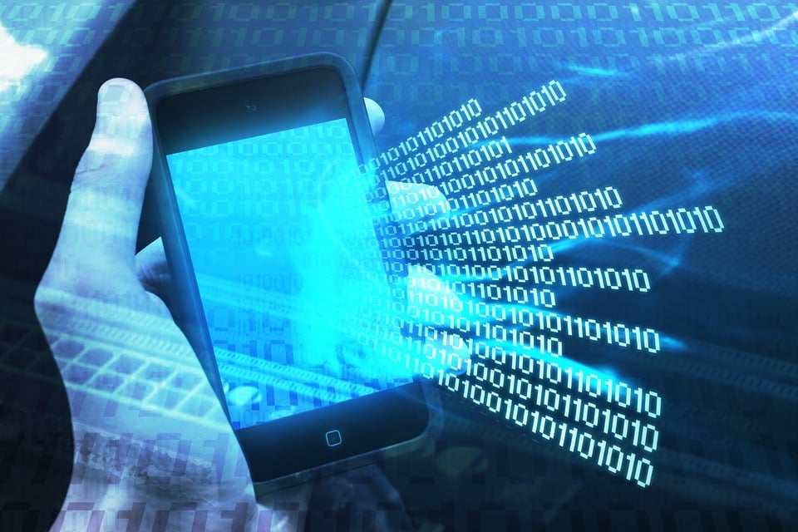
FUTURE SCOPE
The dataset offers opportunities for user segmentation based on behavior patterns like app usage, screen time, and battery drain. Future analysis could focus on predictive models to identify heavy users, optimize battery performance, and forecast data usage. Insights could also be gained from comparing device models and operating systems, enabling personalized recommendations and churn prediction. These analyses would help improve user engagement, app efficiency, and overall device performance.

Slide 18


